Slide 1
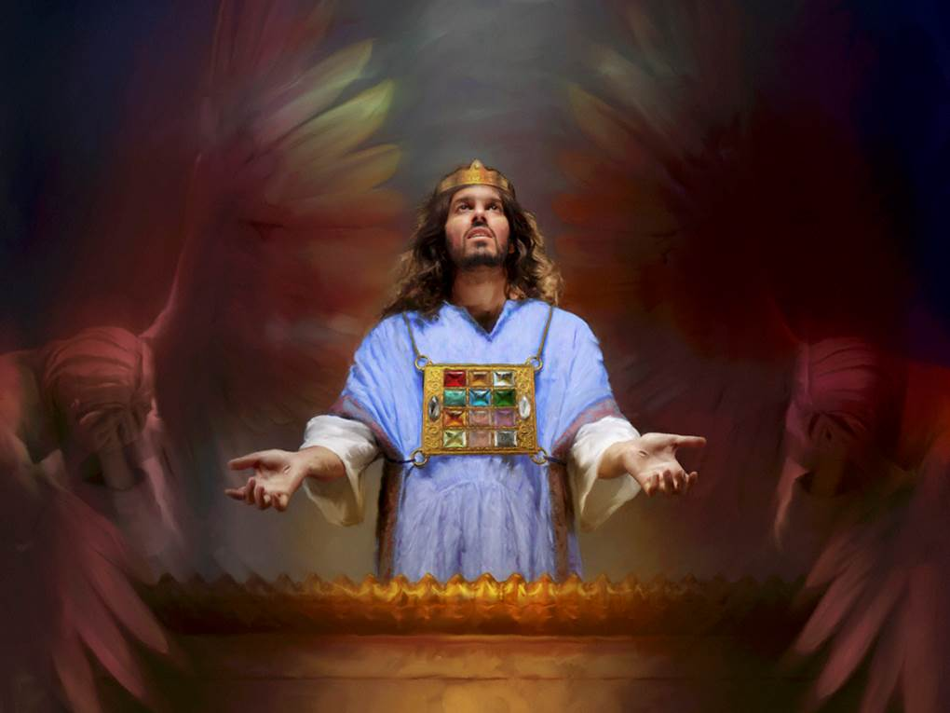
Our Christmas Priest
The Christmas You Never Knew
Genesis 14
Dr. Rick Griffith, Crossroads International Church Singapore
cicfamily.com & BibleStudyDownloads.org

Slide 2
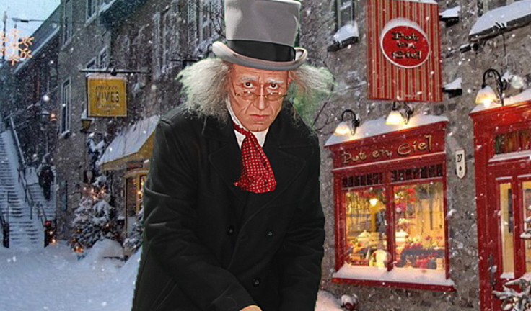
Humbug.
Notes:
The world not only ignores the Christ of Christmas, but attacks him in direct and indirect ways

Slide 3
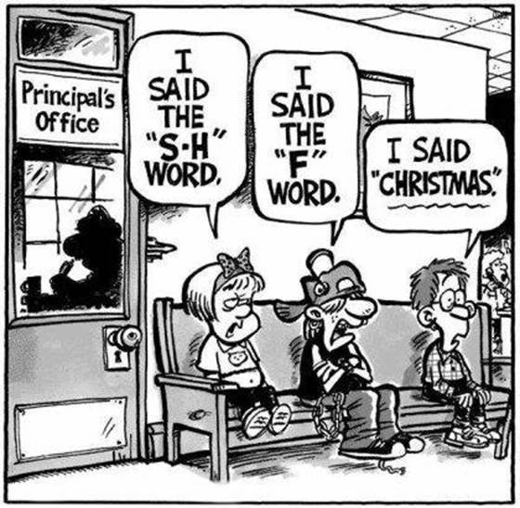
Christmas Shunned
I said the
"S-H" word
I said the "F" word
Principal's Office
I said "Christmas."
Notes:
In some places we get punished for even mentioning Christmas. At the principal's office, one child says, "I said the 'S-H' word," another says, "I said the 'F' word," and still another declares, 'I said 'Christmas.'"

Slide 4
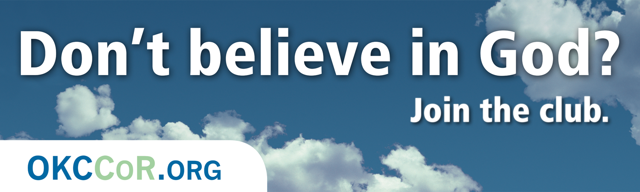
Don't believe in God? Join the club.
Notes:
Atheists directly attack Christmas…

Slide 5
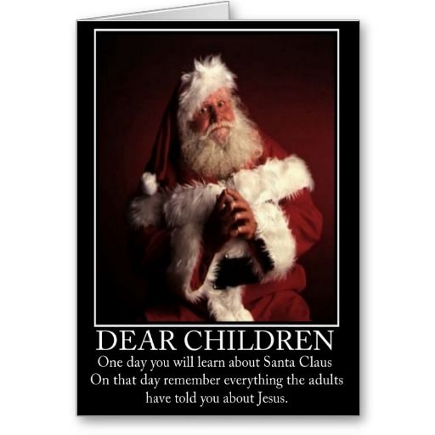
Atheist Christmas Card
DEAR CHILDREN
One day you will learn about Santa Claus. On that day remember everything the adults told you about Jesus.
Notes:
… such as in Christmas cards that equate Jesus and Santa [read card].

Slide 6
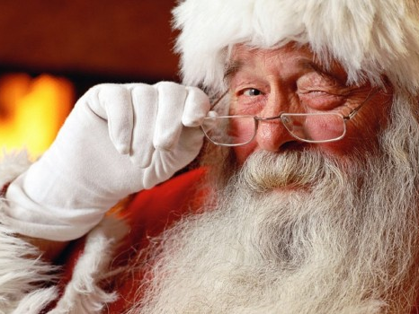
Santa
Notes:
But the fact is that Santa is based on Jesus and, as one blogger notes, "the history of Santa can be a way to teach kids about giving to others. The secular version of Santa that we know today is based on St. Nicholas, who was a Christian man that lived in the third century. When his parents died, they left him a large inheritance and rather than spend it on himself, he decided to give all his money away in an effort to obey Jesus's words to take care of the poor and sick. Some of the traditions that we associate with Santa are based on the stories of St. Nicholas. For example, leaving stockings out for Santa came from tales of St. Nicholas throwing bags of gold through open windows (which apparently sometimes landed in socks and shoes that were left by the fire)." (http://www.tommynelson.com/can-santa-jesus-coexist/).

Slide 7
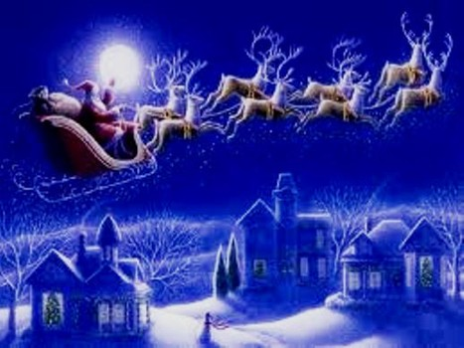
What to do?
Notes:
Do you know what you should do when you see the Christ of Christmas maligned?
• Should you rise up and kill those who dishonor him? No.
• Should you just do nothing and hope it will go away? No.
• Should you do something in between? If so, then what?

Slide 8
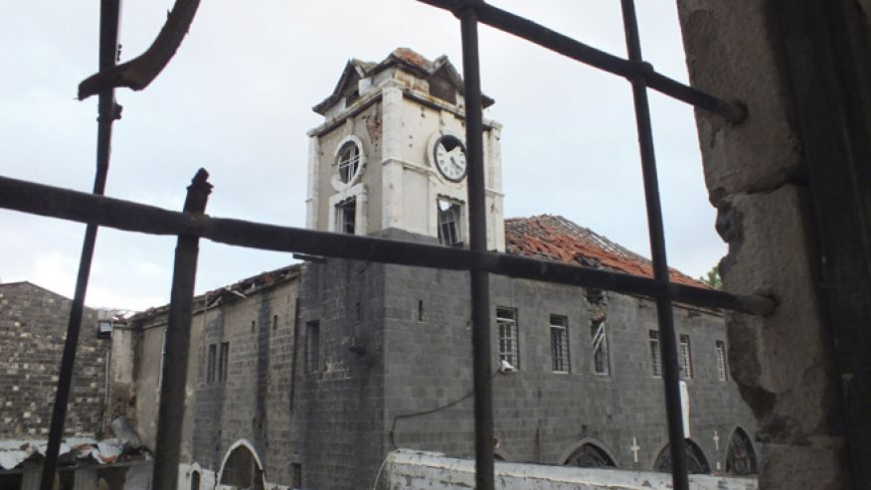
How should we respond to attacks against our faith in God?

Slide 9
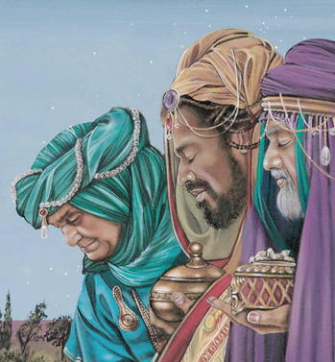
Worship with Gifts
The inferior gave to the superior
Notes:
Let's get the context of our series

Slide 10
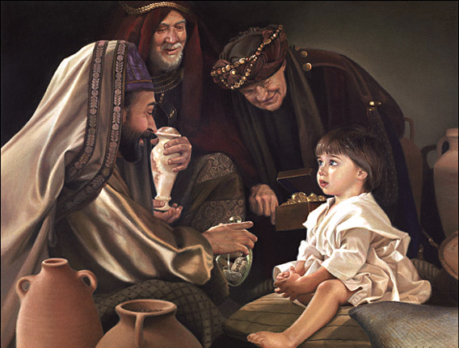
Up to 2 years later…
Notes:
Our three-week series prior to Christmas this year focuses on the three magi gifts…

Slide 11
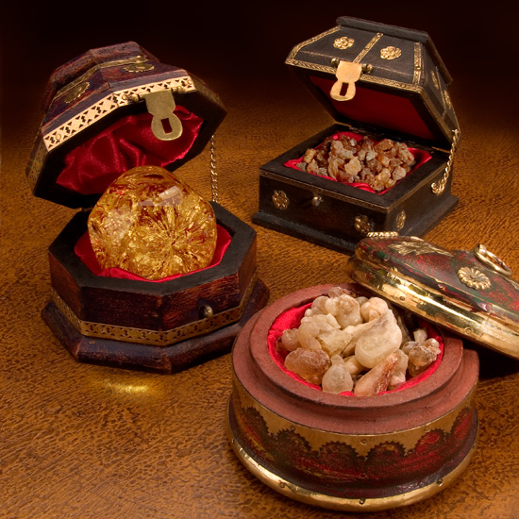
Significant Gifts:
Frankincense
Gold
Myrrh
Notes:
…in their symbolism of three key attributes of Christ…

Slide 12
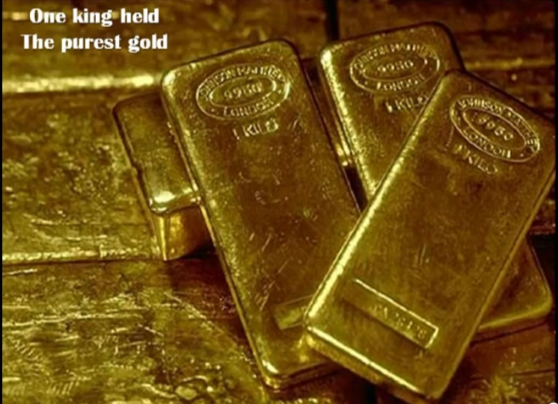
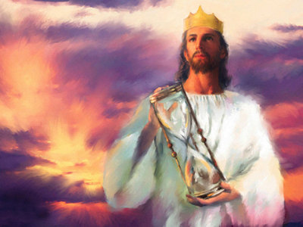
Gold
King
Notes:
Gold is the most precious metal, fit for a King.
• Gold represents royalty—and we discussed this two weeks ago.

Slide 13
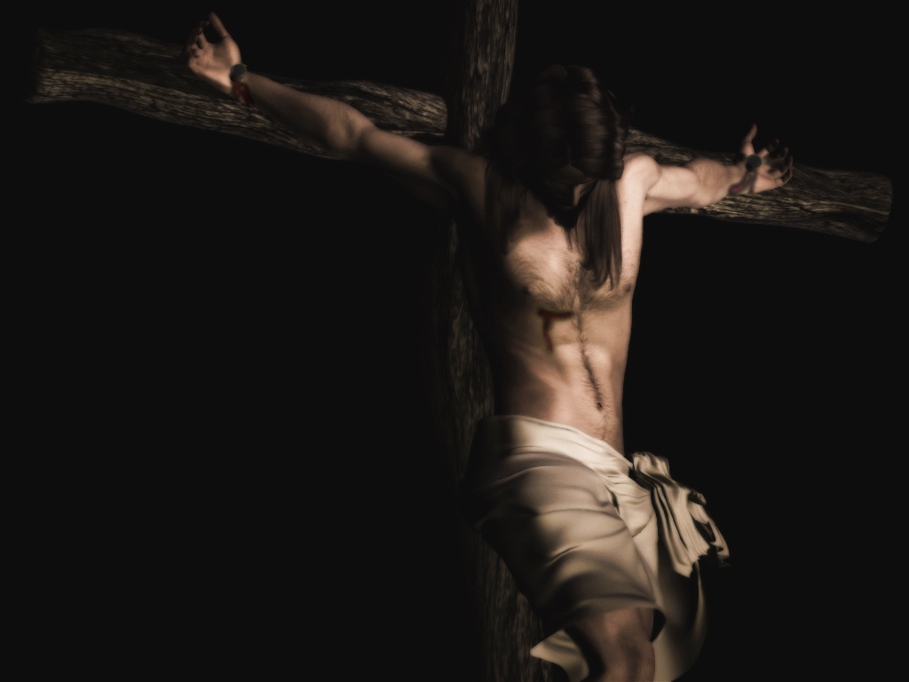
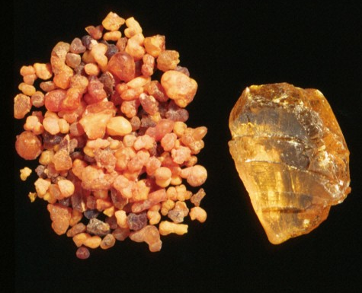
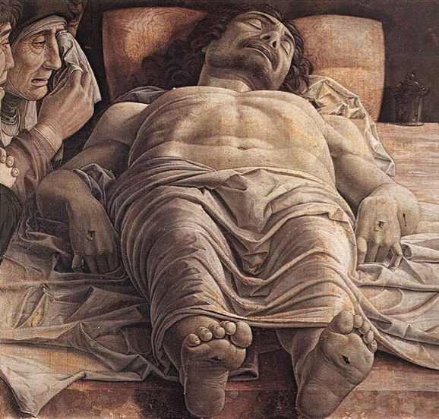
Myrrh
Savior
Notes:
Last week we discussed the gift of myrrh—an even more perplexing gift. Myrrh exudes from a tree in Arabia and was a valuable spice and perfume—and especially an embalming fluid.
Myrrh suggests that Christ would die a sacrificial death (since it was used to wrap bodies after death). It reminds us that Jesus is our Savior. This was used an embalming fluid and thus pointed to Christ's death.
Easton's Bible Dictionary notes, "It was used in embalming ( John 19:39 ), also as a perfume (Esther 2:12 ; Psalms 45:8 ; Proverbs 7:17 ). It was a custom of the Jews to give those who were condemned to death by crucifixion "wine mingled with myrrh" to produce insensibility. This drugged wine was probably partaken of by the two malefactors, but when the Roman soldiers pressed it upon Jesus ["he would not receive it"] ( Mark 15:23 )."
M.G. Easton M.A., D.D., Illustrated Bible Dictionary, Third Edition,
published by Thomas Nelson, 1897. Public Domain, copy freely.
http://www.biblestudytools.com/dictionary/myrrh/
_____
Actually, these three

Slide 14
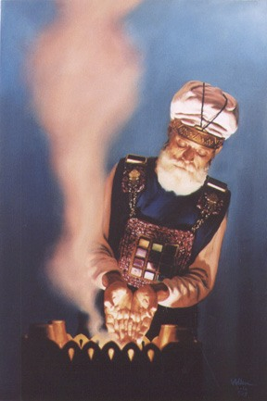
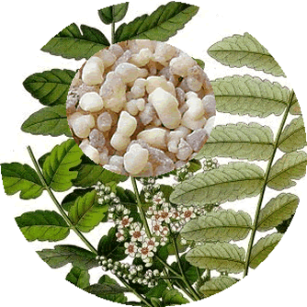
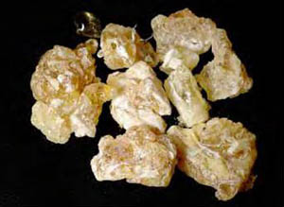
Frankincense
Priest
Notes:
Today we will see the meaning of the last one— frankincense—that emphasizes Christ as Priest.
_____________
Frankincense is a glittering, odorous gum obtained by making incisions in the bark of several trees. It was used as incense.
Frankincense to ease arthritis? See http://www.biblicalarchaeology.org/daily/people-cultures-in-the-bible/jesus-historical-jesus/why-did-the-magi-bring-gold-frankincense-and-myrrh/

Slide 15
The Gift of Frankincense
(Christ as High Priest)
"And the LORD said to Moses: 'Take… pure frankincense with these sweet spices; there shall be equal amounts of each. You shall make of these an incense… and put some of it before the Testimony in the tabernacle of meeting where I will meet with you. It shall be most holy to you. But as for the incense which you shall make, you shall not make any for yourselves, according to its composition. It shall be to you holy for the LORD'" (Exodus 30:34-37).
Notes:
Since priests burned incense in the temple, frankincense likely portrays Christ as our High Priest.
How should we respond to people who reject his role as mediator between man and God?

Slide 16
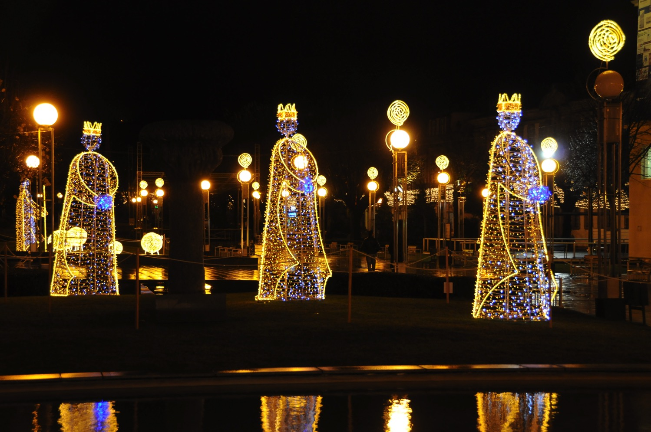
The Christmas You Never Knew
Notes:
Today we continue our series on "The Christmas You Never Knew" when we will answer our magi gift question again by going all the way back to the first book of the Bible.

Slide 17
Significant Gifts:
Frankincense
High Priest
Gold
Ruling King
Myrrh
Redeeming Savior
Notes:
We have seen in Genesis the past two weeks that Jesus is King who sought to share his rule with us (Gen. 1) and Jesus was promised as the Savior once we gave this rule over to Satan (Gen. 3). What about frankincense depicting him as high priest?

Slide 18
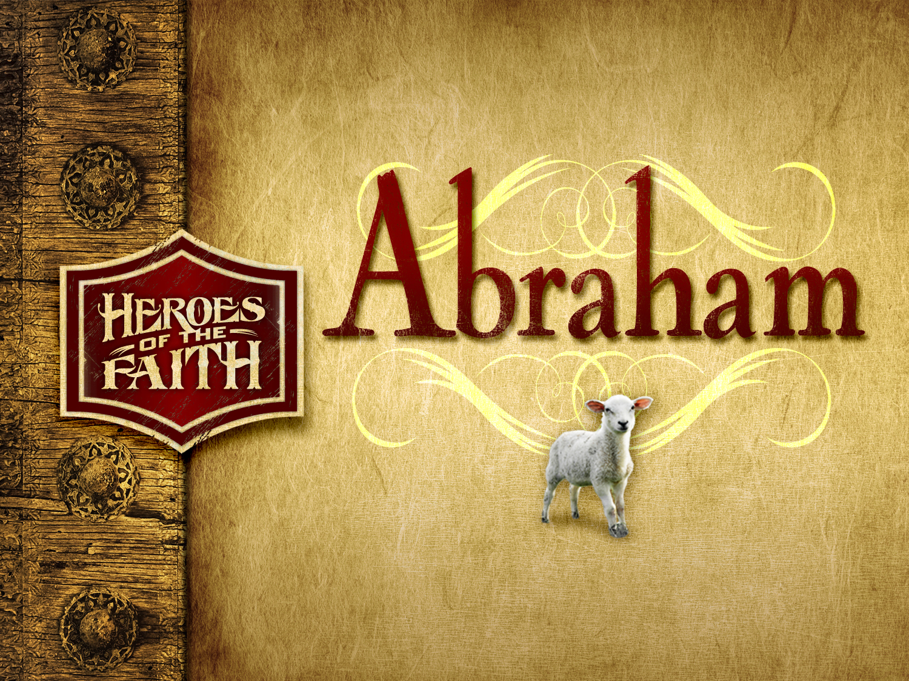

Abraham
Abraham
Heroes of the Faith
Notes:
The priestly idea first appears in Genesis.

Slide 19

The Land of Abraham
93
Genesis 12–24
Haran
Tigris
Euphrates
Canaan
Ur
Egypt
Abraham used to worship the god Sin. After his call he migrated west to obey God but he didn't know where he was going!
Notes:
God promised Abraham a great nation to bless the world when he went to Canaan (Gen. 12:1-3)

Slide 20
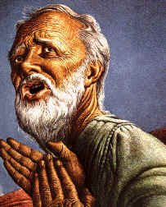
"By Faith…" (Hebrews 11)
"It was by faith that Abraham obeyed when God called him to leave home and go to another land that God would give him as his inheritance. He went without knowing where he was going" (Heb. 11:8 NLT)
Notes:
but, of course, there would be many attacks against Abraham's faith in God

Slide 21
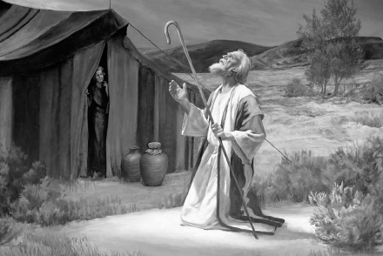
"By Faith…" (Hebrews 11)
"And even when he reached the land God promised him, he lived there by faith—for he was like a foreigner, living in tents. And so did Isaac and Jacob, who inherited the same promise"
(Heb. 11:9 NLT)
Notes:
Abraham was known as the man of faith—but he faced innumerable tests

Slide 22
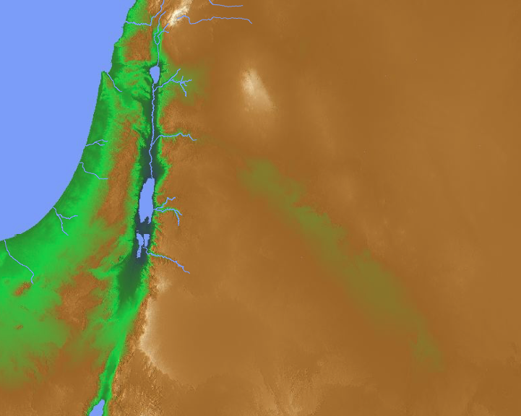
The Land of Canaan
(2000 BC)
Bethel
Abraham
Mamre
Lot
Sodom
Notes:
Most of us really turn to the Lord during times of difficulty and failure, but perhaps one of the hardest tests of faith is success.
Such was the story of Abraham and Lot, who had such success that their flocks were too numerous for the land to sustain them both. Genesis 13 records how Abraham solved the dispute between his herdsmen and Lot's herdsmen by giving his nephew the choice where to live. Lot chose the best land towards Sodom.
Abraham then moved south to Mamre.

Slide 23
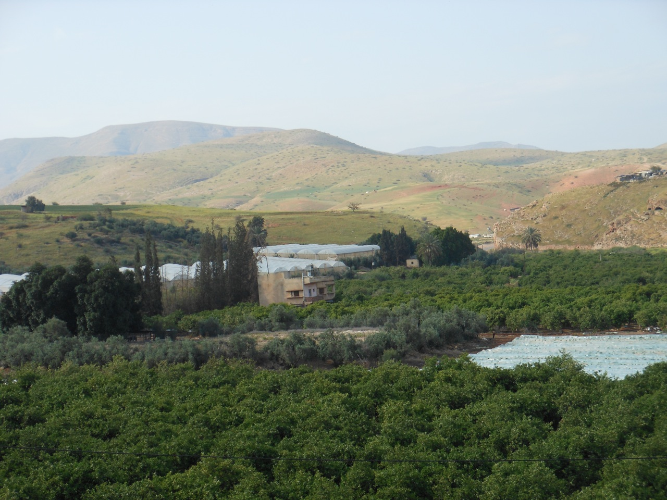
The Lush Jordan Valley
"Lot took a long look at the fertile plains of the Jordan Valley in the direction of Zoar. The whole area was well watered everywhere, like the garden of the LORD" (Gen. 13:10 NLT)
Notes:
Lot chose the fertile plain of the Jordan, despite the fact that it was filled with wicked people (13:13)
__________
Genesis 13:10
"Lot took a long look at the fertile plains of the Jordan Valley in the direction of Zoar. The whole area was well watered everywhere, like the garden of the LORD or the beautiful land of Egypt. (This was before the LORD destroyed Sodom and Gomorrah.) ¹¹ Lot chose for himself the whole Jordan Valley to the east of them. He went there with his flocks and servants and parted company with his uncle Abram. ¹² So Abram settled in the land of Canaan, and Lot moved his tents to a place near Sodom and settled among the cities of the plain. ¹³ But the people of this area were extremely wicked and constantly sinned against the LORD" (NLT).

Slide 24
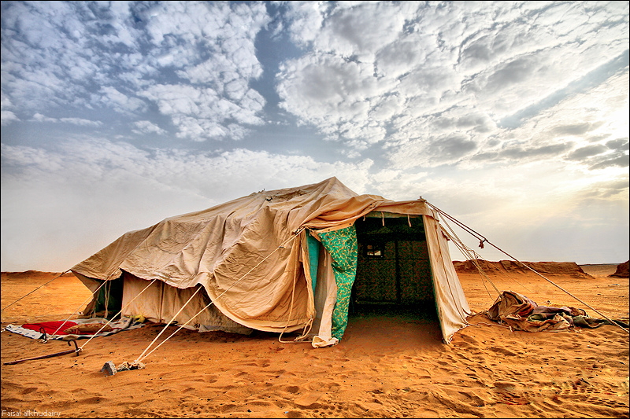
Lot first pitched his tent near Sodom
Notes:
Sometimes attacks against our faith come through the allurement of the world, which certainly affected Abraham's nephew, Lot. After moving close to Sodom…
___________
"So Abram settled in the land of Canaan, and Lot moved his tents to a place near Sodom and settled among the cities of the plain. ¹³ But the people of this area were extremely wicked and constantly sinned against the LORD" (13:12-13 NLT).

Slide 25
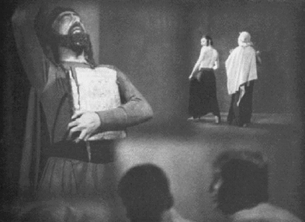
But soon Lot was living in Sodom
Notes:
Lot failed the test of faith by moving into Sodom—the successful, comfortable and affluent Sodom that was the wickedest city on earth

Slide 26
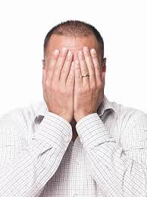
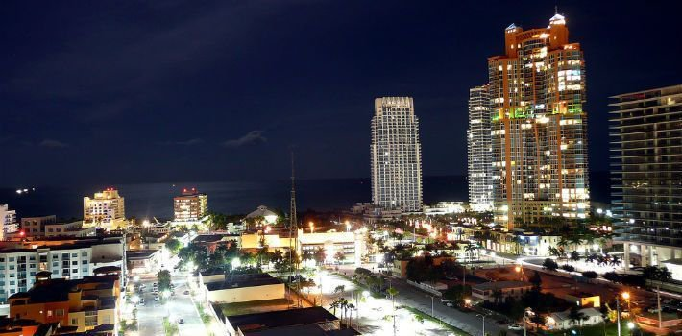
Perils of Success
Notes:
Today evil people still use money and power to push out righteous people from the most beautiful places on earth!

Slide 27
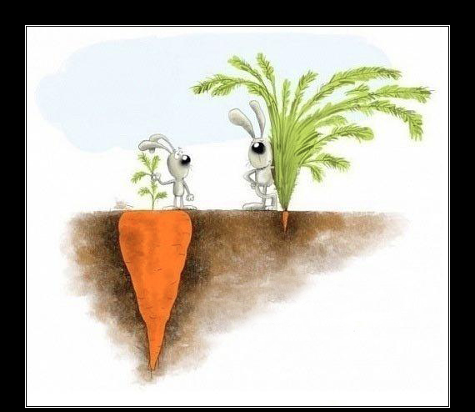
SUCCESS
is not always what you see
Notes:
Abraham could see that true success is not always what you see now—so he could properly respond to attacks against godly values.
hateandanger.wordpress.com

Slide 28
How should we respond to attacks against our faith in God?
2 ways
Gen. 14
Notes:
Today in the story of Abraham we will see two ways to respond to attacks against our faith in God.
Genesis 14 reveals two ways that Abraham addressed attacks against the Lord.
So how should we respond to attacks against our faith in God? First…

Slide 29
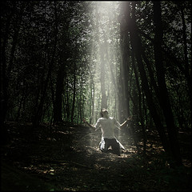
I. Trust God for victory.
Notes:
Take action against direct attacks by trusting in God in practical ways.

Slide 30
Kings from the East
Kedorlaomer Expansion
Elam
Mediterranean
Sea
Babylon
Canaan
Persian
Gulf
Egypt
Notes:
Abraham recaptured Lot after kings invaded the Promised Land (14:1-16).
Here we see a different kind of "kings from the east" than the typical Christmas story!

Slide 31
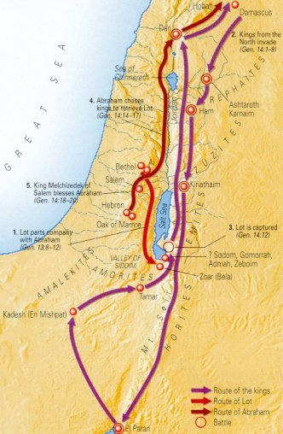
Dan
The Land of Canaan
(2000 BC)
5 Kings
Salem
Abraham
Mamre
Sodom
Kadesh
How could Abraham win?
• Allies Aner, Eshcol, and Mamre (14:13, 24)
• Surprise night attack
• God
El Paran
Notes:
Basically, we have four eastern kings against five Jordanian kings (1-7).
They fought at the south end of the Dead Sea, near Sodom where Lot lived.
The five Jordanian kings lost the battle and Lot was carried far north (8-12).
Then Abraham rescued Lot, the goods, women and captives at Dan and Hobah (13-16).
How could Abraham defeat these four powerful kings with only 318 men (14-16)?
Humanly speaking, he had his allies Aner, Eshcol, and Mamre (14:13, 24)—plus he had the advantage of a surprise night attack. However, Abraham was quick to give God the full credit as he agreed with Melchizedek's praise to God for granting him the victory (14:20)

Slide 32
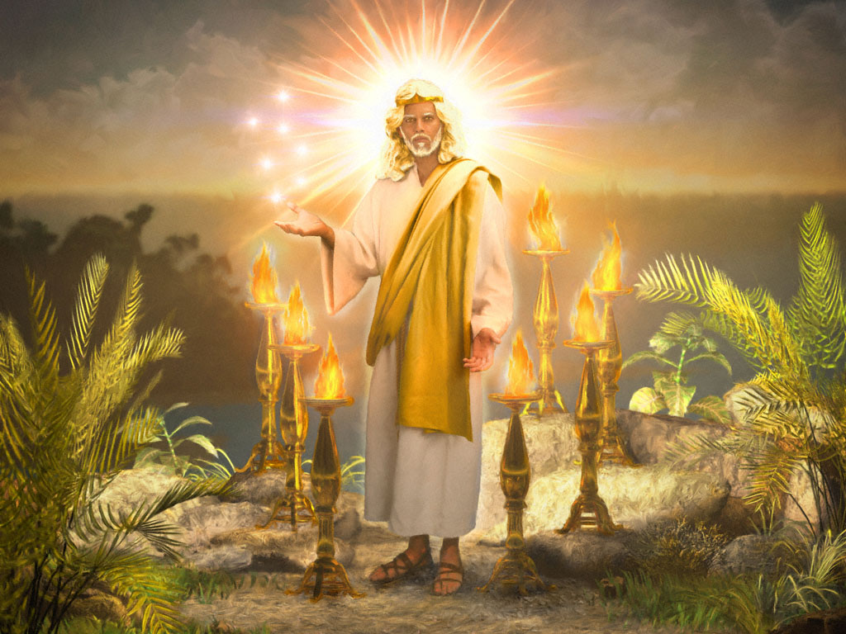
We must support righteousness with the resources he has given us.
How and where?
• Work
• Home
• Mind
Notes:
Many forces oppose us.
But God gives us all we need for victory.
We have already studied this year about Christ as Victor in the book of Revelation!
Seven stars (angels) are in his hands and he walks with authority among the lampstands (churches).
How and Where do we support righteousness?
At work do we hold back evil and represent Christ?
At home do we influence our family members towards holiness?
Do we fill our minds with pure thoughts?

Slide 33
I. Trust God for victory.
Notes:
So Abraham trusted God for victory and saw the Lord honor him too.

Slide 34

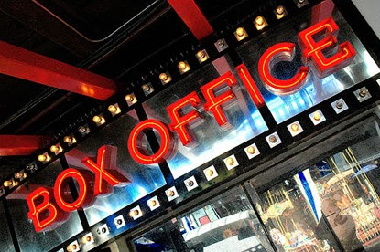
Our greater danger is not failure. It is success.
Notes:
After his successful raid against impossible odds, would Abraham take credit for this or worship the Lord Most High? This next section reminds us to humbly place our faith in God when this faith is attacked even by our success! So how else should we respond to attacks against our faith in God?

Slide 35
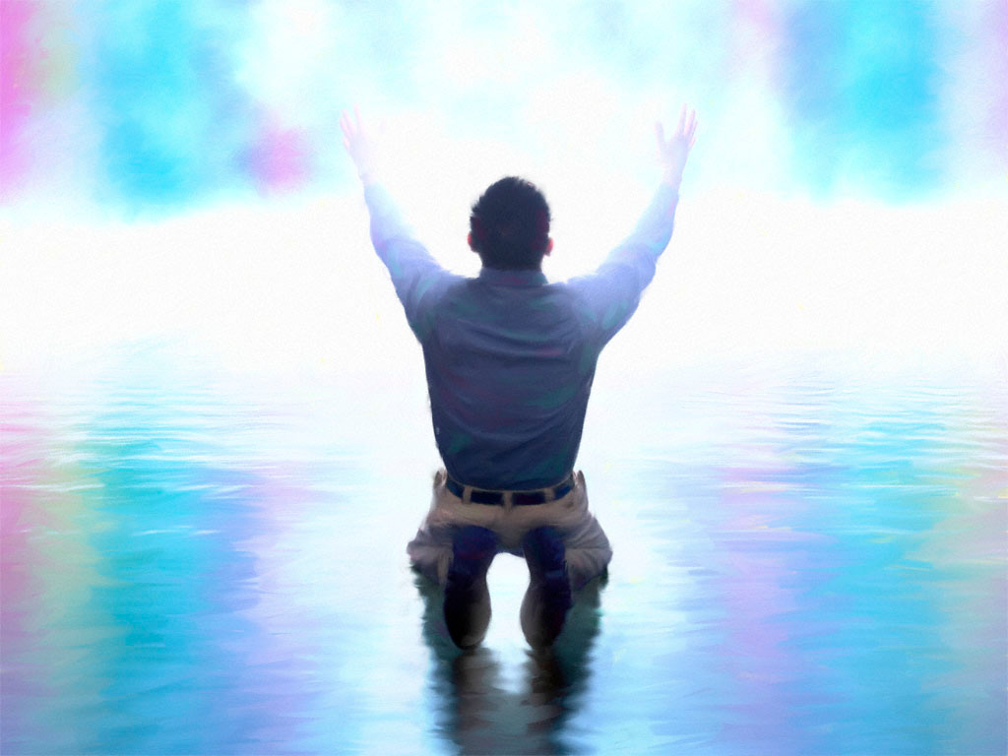
II. Credit God for his victories in your life (17-24).
Notes:
Blame the Lord for success in your conflicts.

Slide 36
Dan
The Land of Canaan
(2000 BC)
5 Kings
Salem
Abraham
Mamre
King of Sodom
Sodom
Kadesh
El Paran
Notes:
Two Offers: Two vastly different kings came to Abraham after his victory (17-20a).

Slide 37
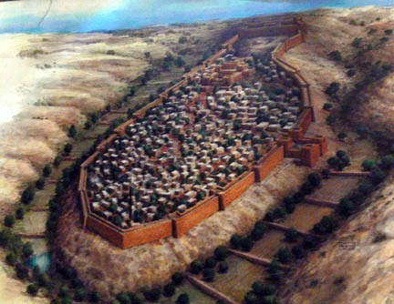
Genesis 14:17-21
Abraham
Valley of Shaveh
King of Sodom
Notes:
Bera, king of Sodom, came first to Abraham at Jerusalem (17).

Slide 38
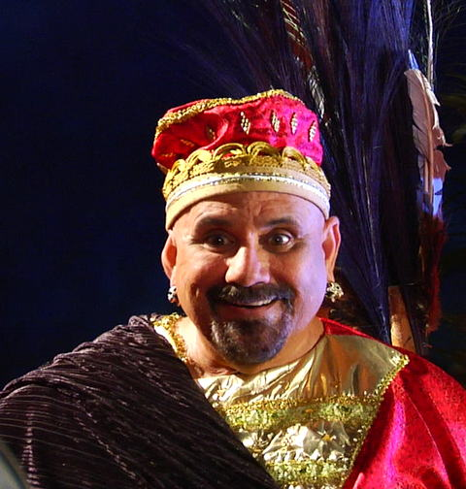
King of Sodom
Notes:
Why would Sodom's evil king (14:2) congratulate the godly Abraham (17a)?
He wouldn't care if Abraham were evil or good.
Like any person—even an evil person—he would have been pleased to have his people back. Without people, he wouldn't have been a king!

Slide 39
Genesis 14:17-21
Abraham
Valley of Shaveh
King of Sodom
Notes:
Where was the Valley of Shaveh, or King's Valley (17b)?
• Some (e.g., Beitzel, New Moody Atlas of the Bible, 103) say it was west of Jerusalem.
• Others say south of the city (e.g., New Bible Commentary).
• But the best guess is that this is the Kidron Valley just east of Jerusalem (BKC, bible.ca, israel-a-history-of.com, etc.).

Slide 40
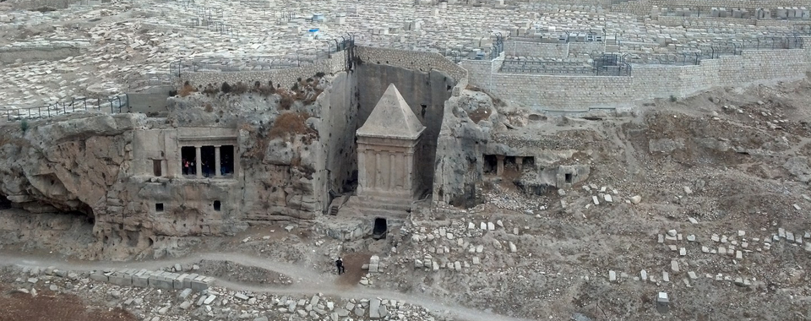
The Valley of Shaveh
"During his lifetime, Absalom had built a monument to himself in the King's Valley, for he said, 'I have no son to carry on my name.' He named the monument after himself, and it is known as Absalom's Monument to this day" (2 Sam. 18:18 NLT)
Absalom's Pillar
Notes:
We see the Kidron Valley called the King's Valley in 2 Samuel 18:18

Slide 41
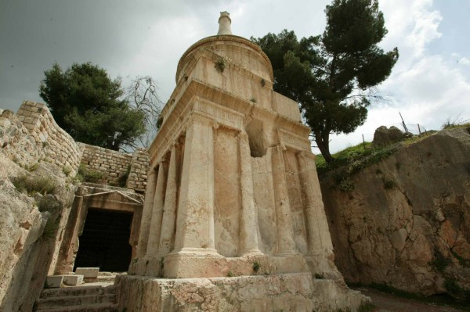
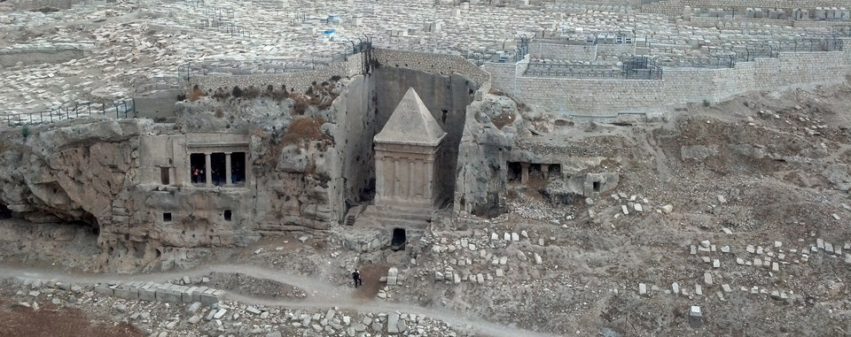
The Valley of Shaveh
Absalom's Pillar
Notes:
The interesting thing is that Bera would travel all the way there! Also, evidently Abraham went to Jerusalem instead of to Sodom. Perhaps he didn't even want to get close to Sodom.

Slide 42
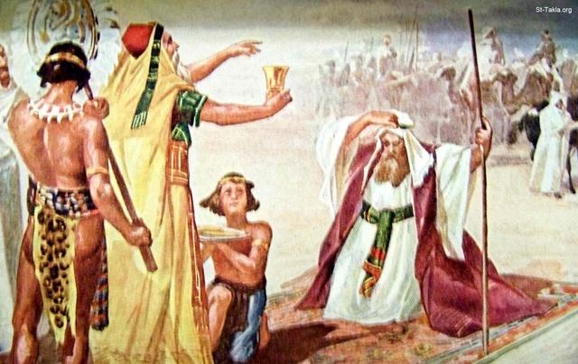
"And Melchizedek, the king of Salem and a priest of God Most High, brought Abram some bread and wine"
(14:18 NLT).
Notes:
Melchizedek, king of Jerusalem, then came to Abraham with bread and wine, and blessed him (18-20a).

Slide 43
Genesis 14:19-20
Abraham
"Blessed be Abram by God Most High, Creator of heaven and earth.
²⁰And blessed be God Most High, who has defeated your enemies for you!"
Valley of Shaveh
Melchizedek
King of Sodom
Notes:
Read 19-20
Is there a direct contrast between these two kings (17-21)?

Slide 44
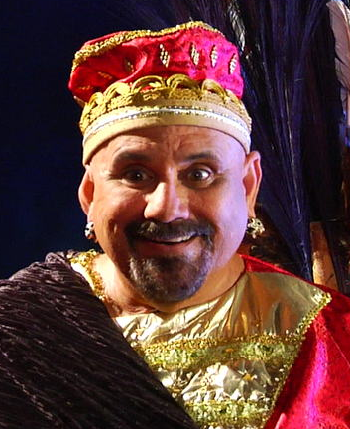
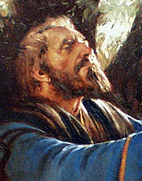
Vast Differences!
Bera
Melchizedek
Wicked King
of Sodom
King of Righteousness
Notes:
"This is one of the most fascinating encounters in the Old Testament. Two kings met Abram on his return from the battle, and they could not possibly have been more different.
In contrast with the wicked city of Sodom and its ruler Bera (v. 2), who also was undoubtedly wicked, was Melchizedek king of Salem (i.e., Jerusalem, Ps. 76:2), a priest of God Most High (Gen. 14:18). Melchizedek's name (which means 'king of righteousness') suggests a righteous ruler who was God's representative" (Allen P. Ross, "Genesis," BKC, 54).

Slide 45
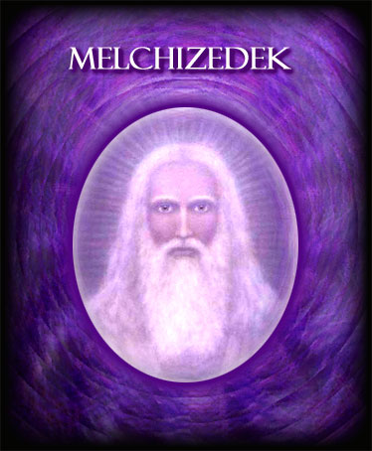
Melchizedek

Slide 46
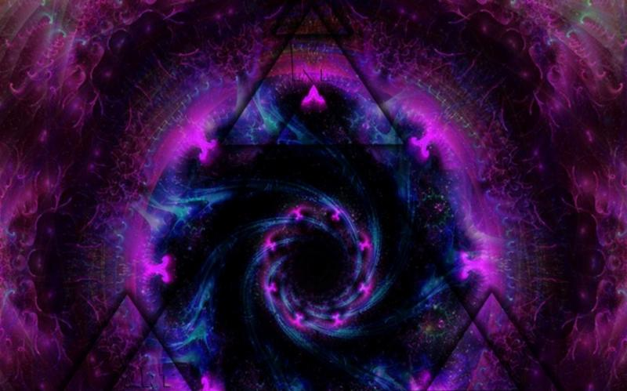
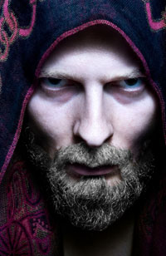
Melchizedek
Who was he?
Notes:
Some depict Melchizedek as an evil
http://www.godawa.com/chronicles_of_the_nephilim/abraham_characters.html
Abraham Allegiant: Chronicles of the Nephilim Book Four
Biblical Epic Fantasy by Brian Godawa

Slide 47
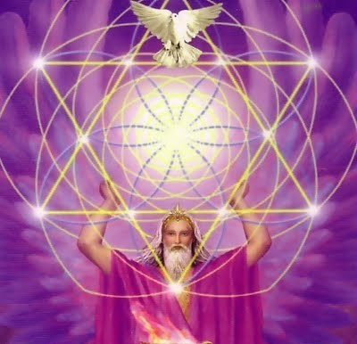
The Mystical Melchizedek

Slide 48
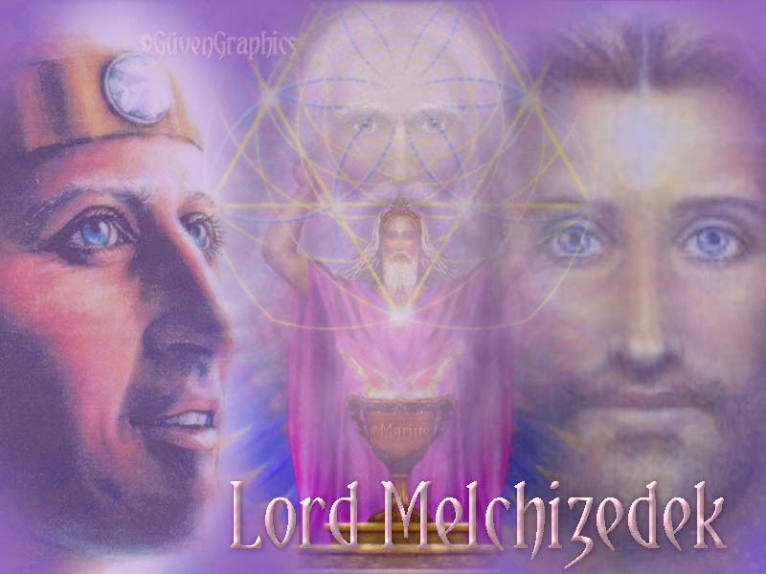
Melchizedek
Notes:
Was he lord—whatever that means to these mystics?

Slide 49
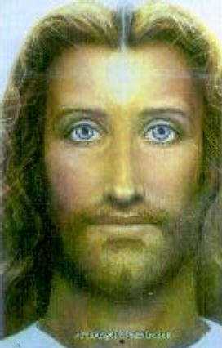
Melchizedek
The Pre-Incarnate Christ?
Notes:
Was he Jesus?

Slide 50
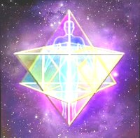
The Angel Melchizedek
Notes:
Some see him as an angel.

Slide 51

Melchizedek
(Judaism; New Age)
"…Ancient mystical texts describe Melchizedek as one who conducts spirit releasement on a massive scale, working in conjunction with Archangel Michael."
http://www.angelsandmasters.net/A57.html

Slide 52


Mormon Priesthood
A painting depicting the restoration of the Melchizedek Priesthood by Peter, James, and John
Mormonbeliefs.org
Notes:
"The Melchizedek Priesthood was restored next, bringing to earth all the power and authority necessary to organize and direct the Church of Jesus Christ and to perform additional saving priesthood ordinances.
Smith and Cowdery did not record the actual date that they received the Melchizedek Priesthood, but historical records and testimony of witnesses place the ordination within the 13-day period of 16th to 28th of May, 1829.
The Melchizedek Priesthood was conferred upon them by Christ's Apostles Peter, James and John, Peter and James as resurrected beings, and John as a translated being.
With the restored priesthoods—the Prophet Joseph Smith and Oliver Cowdery— organized the Church of Jesus Christ with proper authority. This occurred on April 6th 1830. The restoration of priesthood authority was necessary to re-establish God's kingdom on earth in preparation for the Second Coming of Jesus Christ and ushering in of His millennial reign. This is called "the last dispensation of time," also "the fullness of times," since all things pertaining to the kingdom of God on earth must be gathered in, fulfilled.
For Mormons, authority is a key element of the gospel. Apostolic succession is a requisite, and this authority is not derived from the people, but rather from the Lord himself and his authorized servants."
http://mormonbeliefs.org/mormon_beliefs/mormon-beliefs-the-great-apostasy-and-the-restoration/what-is-mormon-priesthood/mormon-priesthood-a-history accessed 19 Dec 2014

Slide 53


Melchizedek Church
Notes:
There is even a church in Sacramento, California named after him!

Slide 54

Who really was Melchizedek?
"King of righteousness"
King of Jerusalem (cf. Ps. 76:2)
Priest of God Most High
Notes:
Godly—Most Canaanites were evil at this time, but this king is an exception.
Salem is parallel to Zion, or Jerusalem, in Psalm 76:2, "His tabernacle is in Salem; His dwelling place also is in Zion" (NAU)
"Jerusalem" means "city (uru) of Salem (pagan deity)." Not this man!
"Priest of God Most High" can only mean that he functioned as a mediator (priest) between man and God—even Abraham and God!
Here is the first time the word "priest" appears in the Bible.

Slide 55

The Aaronic High Priest
Notes:
This is, therefore, the first mention of another person is aid a human in worship of the true God.
Just north of this same location 500 years later God would institute another priesthood with the descendants of Aaron.

Slide 56
One Decision
Bera
Melchizedek
Wicked King
of Sodom
King of Righteousness
Notes:
One Decision: Abraham accepted Melchizedek's blessing rather than identify with Sodom (20b-24).

Slide 57

"Then Abram gave Melchizedek a tenth of all the goods he had recovered" (14:20b NLT).
Notes:
Why would Abraham pay tithes to Melchizedek (20b)?

Slide 58

Melchizedek
Notes:
Ross write, "Melchizedek is the only person whom Abram recognized as his spiritual superior. Abram accepted blessing from him (v. 19), and Abram paid him a 10th (a tithe) of all he had (v. 20). Abram did this deliberately, in full awareness of what he was doing. It shows how unthreatened and humble Abram was, even after a victory. He recognized that God's revelation was not limited to him. While the reader's attention is focused on Abram carrying the whole spiritual hope of the world, there emerged out of an obscure Canaanite valley a man nearer to God than Abram was, who blessed Abram" (Allen P. Ross, "Genesis," BKC, 54).

Slide 59

http://www.coastec.net.au/honouring-gods-priest-king-genesis-135-1424/
Notes:
Again: "Melchizedek is an important figure in the Bible. Preceding Abram, he was not a Levitical priest. When David, the first Israelite king to sit on Melchizedek's throne, prophesied that his great Descendant, the Messiah, would be a priest forever after the order of Melchizedek (Ps. 110:4), David looked beyond the Levitical priesthood which would be done away with. The Book of Hebrews demonstrates how Jesus Christ in His death fulfilled the Levitical order and began a better high priesthood. In referring to Melchizedek as the perfect type of Christ, the writer of Hebrews capitalized on Melchizedek's anonymity: in a book (Gen.) filled with genealogies and ancestral notations, this man appeared without family records (Heb. 7:3). Melchizedek is remembered as a high priest. Because Abram paid tithes to Melchizedek, the order of Melchizedek is superior to Levi, who descended from Abram (Heb. 7:4-10)" (Allen P. Ross, "Genesis," BKC, 54)

Slide 60
Genesis 14:19-20
Abraham
"Blessed be Abram by God Most High, Creator of heaven and earth.
²⁰And blessed be God Most High, who has defeated your enemies for you!"
Valley of Shaveh
Melchizedek
"I've got a deal for you!"
King of Sodom
Notes:
Abraham wanted to assure that he put his money on the eternal rather than on the temporary things of this world. So…

Slide 61
Offer Rejected
"The king of Sodom said to Abram, 'Give back my people who were captured. But you may keep for yourself all the goods you have recovered.' ²²Abram replied to the king of Sodom, 'I solemnly swear to the LORD, God Most High, Creator of heaven and earth, ²³that I will not take so much as a single thread or sandal thong from what belongs to you. Otherwise you might say, "I am the one who made Abram rich." ²⁴I will accept only what my young warriors have already eaten, and I request that you give a fair share of the goods to my allies—Aner, Eshcol, and Mamre'" (14:21-24 NLT).
Notes:
Abraham rejected Bera's deal by accepting nothing from him except what his allies wanted (21-24).
The offer by Sodom couldn't compare with God's blessing!

Slide 62
One Decision
Bera
Melchizedek
Wicked King
of Sodom
King of Righteousness
"Give back my people…"
"Blessed be Abram…"
Notes:
Was this a hard decision? Abraham had already given Melchizedek a tithe before Bera even made his offer! Instead of keeping all the spoils of war and thus identify with Sodom, he chose God's blessing instead!
As the OT scholar Ross notes, "Abram knew that he would become more prosperous, and he knew who was blessing him. He intended to receive everything from God and not even a thread from Sodom. Obedient believers frame their lives so that for all success, joy, comfort, and prosperity they depend on God—but their faith is like Abram's, deeply rooted and growing stronger rather than brief and weak. The king of Sodom was obviously a wicked man over a wicked empire; Abram discerned that dealing with him might be dangerous" (Ross, "Genesis," BKC, 54)

Slide 63


Series on the Book of Hebrews
We must credit Jesus as our Mediator with God
JESUS
the great high priest

Slide 64
Genesis 22
Mount Moriah
Abraham
Valley of Shaveh
Notes:
Abraham would later face the biggest challenge of his life just above this valley when he needed another mediator with God…

Slide 65

"By Faith…" (Hebrews 11)
"Abraham reasoned that if Isaac died, God was able to bring him back to life again. And in a sense, Abraham did receive his son back from the dead"
(Heb. 11:19 NLT)
Notes:
… in the form of an angel to stop him from offering Isaac as a sacrifice.

Slide 66


1 Kings 6–9
Christ's Death
Solomon's Temple
Abraham
Valley of Shaveh
Notes:
Little did Abraham realize that 1000 years later, Solomon would build the temple at the top of the hill—and 1000 years after that, the Messiah would bear the sin of the world just outside the city!

Slide 67

The Order of Melchizedek
Notes:
We must worship Jesus as a priest in the order of Melchizedek.

Slide 68

David Prophesied of Jesus
"The LORD has taken an oath
and will not break his vow:
'You are a priest forever in the order of Melchizedek'"
(Ps. 110:4 NLT).
Notes:
This order of priests did not depend upon geneaology but godliness!
"That ancient unity of priest and king in one person will be reunited in the Messiah, a fact which necessitates the end of the line of Aaron's priesthood. This is precisely the point of the writer to the Hebrews, who four times said Melchizedek is a type of Christ (Heb. 5:6; 6:20; 7:17, 21)" (BKC).

Slide 69
How should we respond to attacks against our faith in God?
Notes:
Well, as I noted earlier, very few people know the truth about Christmas or Christ as priest—so they ridicule you and me. So how should we respond to attacks against our faith in God? We should…

Slide 70

Defend and worship Christ as God's priest
Main Idea
Notes:
When you are opposed…

Slide 71
I. Trust God for victory.
Notes:
So Abraham trusted God for victory and saw the Lord honor him too.

Slide 72
II. Credit God for his victories in your life (17-24).
Notes:
Blame the Lord for success in your conflicts.

Slide 73

What should we do?
Like Abraham, defend God's honor against attackers.
Like Abraham, accept God's blessing instead of the best the world can offer.
Trust in Christ as God's appointed Mediator-Priest.

Slide 74
Black

Slide 75


OT Preaching link at BibleStudyDownloads.org
Get this presentation and script for free!
Notes:
OT Preaching (op)

